Slide 1

Presented by: Debdoot Manna
spotify mod apk download without any virus
A Single Traversal Algorithm Approach
Finding the First k Non-repeating Characters in a String in a Single Traversal

Slide 2
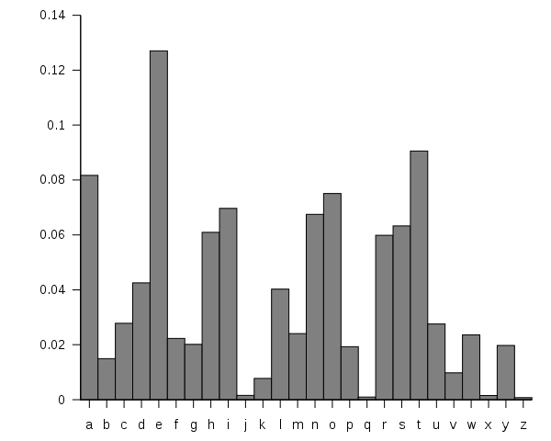

Character frequency analysis is a fundamental operation in text processing
Finding non-repeating characters has applications in:
Data compression
Cryptography
Pattern recognition
Text analysis
Today's focus: An efficient algorithm to find the first k non-repeating characters in a single traversal
Introduction
Feeling bored already?

Slide 3


Problem Definition
I/O
Important...
Input:
A string s of length n
An integer k representing the number of non-repeating characters to find
Output:
The first k characters from the string that appear exactly once
Constraint:
Must be solved in a single traversal of the string
Optimize for both time and space complexity

Slide 4


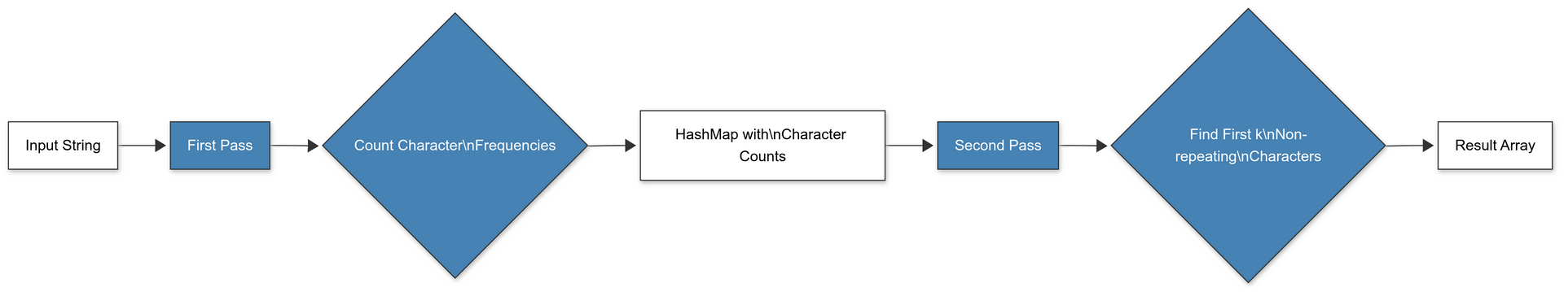
 | A simple approach would require multiple traversals: Count frequency of each character Scan the string again to find non-repeating characters
 | Issues with this approach: Time complexity: O(n + n) = O(n), but requires multiple passes Not optimal for streaming data or very large strings Doesn't handle dynamic updates efficiently
Naive Approach
Why Not Multiple Traversals?

Slide 5


Single Traversal Algorithm
How to get out from here..
Our goal: Find the first k non-repeating characters in a single pass
Key data structures:
HashMap: To track character frequencies
Queue: To maintain the order of characters as they appear
Main idea:
Process each character once
Use the data structures to efficiently identify and retrieve non-repeating characters
Run
I am just doing this because I was told to do it...
Compile
Note: If I stutter, its because I am bored

Slide 6
HashMap (Dictionary)
Character from the string
Frequency count of the character
Maintains the order of characters as they appear in the string
Allows for efficient retrieval of the first non-repeating characters
Key
Value
Queue
O(1) average time for insertion and lookup
O(1) for enqueue and dequeue operations
Time complexity benefits
HashMap
Queue

Slide 7
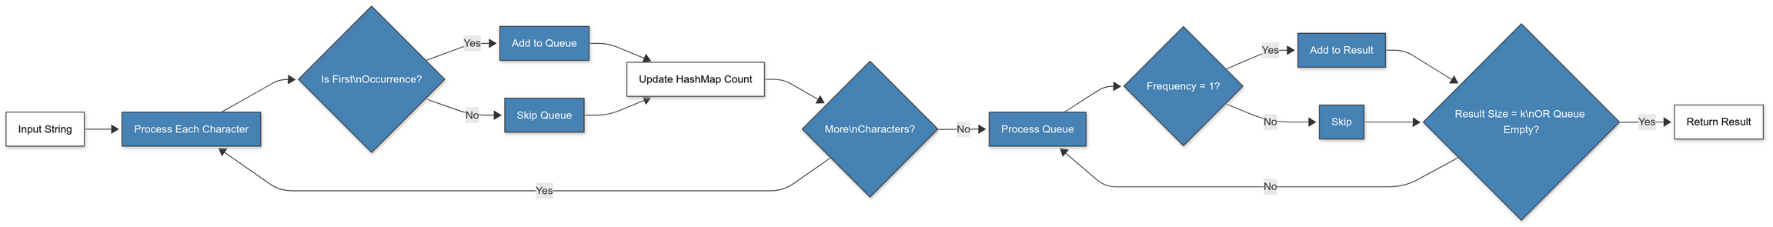

 | Algorithm Steps
 | Step-by-Step Procedure
1
2
3
4
5
Initialize an empty HashMap to store character frequencies | Initialize an empty Queue to maintain character order | Process each character in the string: Increment its count in the HashMap Add the character to the Queue if it's encountered for the first time | After processing all characters: Dequeue characters and check their frequency in the HashMap If frequency is 1, add to result list Continue until k non-repeating characters are found or queue is empty | Return the first k non-repeating characters

Slide 8
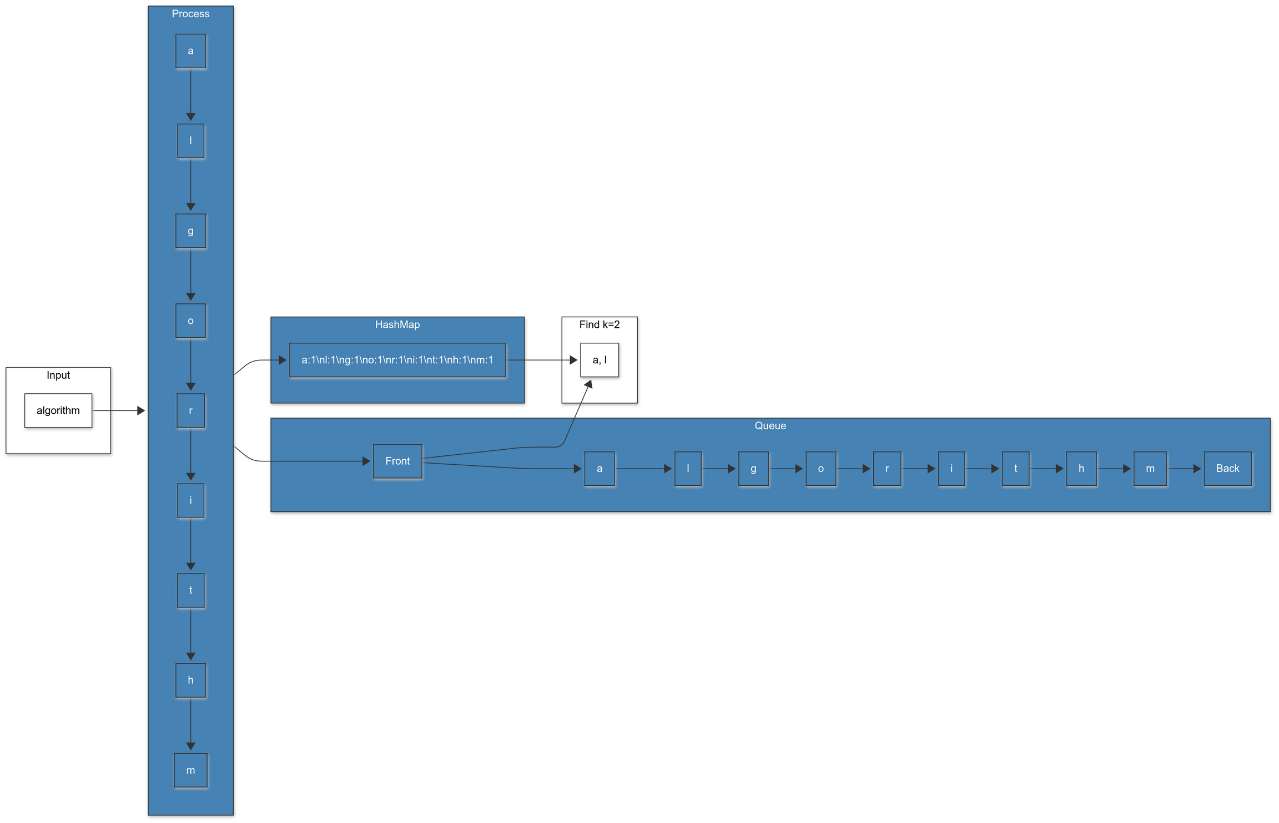
Algorithm Visualization
Algorithm in Action

Slide 9
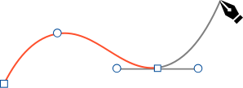
Processing the String
Input: s = "algorithm", k = 2
Process each character:
'a': Add to Queue, HashMap = {a:1}
'l': Add to Queue, HashMap = {a:1, l:1}
'g': Add to Queue, HashMap = {a:1, l:1, g:1}
'o': Add to Queue, HashMap = {a:1, l:1, g:1, o:1}
'r': Add to Queue, HashMap = {a:1, l:1, g:1, o:1, r:1}
'i': Add to Queue, HashMap = {a:1, l:1, g:1, o:1, r:1, i:1}
't': Add to Queue, HashMap = {a:1, l:1, g:1, o:1, r:1, i:1, t:1}
'h': Add to Queue, HashMap = {a:1, l:1, g:1, o:1, r:1, i:1, t:1, h:1}
'm': Add to Queue, HashMap = {a:1, l:1, g:1, o:1, r:1, i:1, t:1, h:1, m:1}
Sorry for my poor editing skills
Still in learning progress...

Slide 10
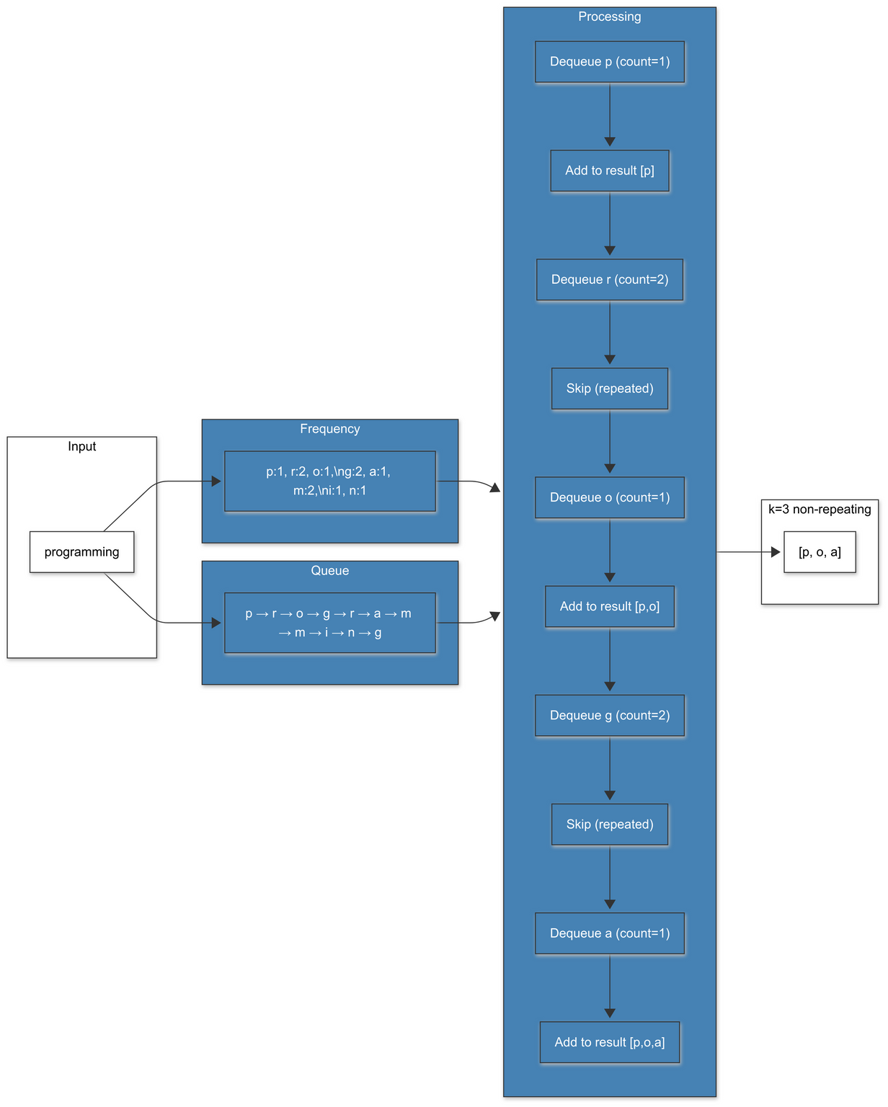


Finding Non-repeating Characters
After processing the string "algorithm":
Queue contains: [a, l, g, o, r, i, t, h, m]
All characters have frequency 1 in the HashMap
Results:
First non-repeating character: 'a'
Second non-repeating character: 'l'
Final output: ['a', 'l']

Slide 11
Code Implementation
*this section is for nerds

Slide 12
OnlyNerds
Algorithm Implementation in Python
from collections import Counter
from queue import Queue
def first_k_non_repeating(s, k):
# Initialize counter for character frequencies
char_count = Counter()
# Queue to maintain order of characters
char_queue = Queue()
# List to store the result
result = []
# Process each character in the string
for char in s:
# Increment the character count
char_count[char] += 1
# Add character to queue if it's the first occurrence
if char_count[char] == 1:
char_queue.put(char)
# Find the first k non-repeating characters
while not char_queue.empty() and len(result) < k:
# Get the next character from the queue
char = char_queue.get()
# Add to result if it appears exactly once
if char_count[char] == 1:
result.append(char)
return result
# Example usage
s = "programming"
k = 3
print(first_k_non_repeating(s, k)) # Output: ['p', 'o', 'a']
Kindly don’t ask coding questions...

Slide 13


#include <iostream>
#include <string>
#include <unordered_map>
#include <queue>
#include <vector>
std::vector<char> firstKNonRepeating(const std::string& s, int k) {
// Map: char frequencies
std::unordered_map<char, int> count;
// Queue: char order
std::queue<char> q;
// Result: non-repeating chars
std::vector<char> res;
// Process string
for (char c : s) {
count[c]++;
if (count[c] == 1) q.push(c);
}
// Find k non-repeating
while (!q.empty() && res.size() < k) {
char c = q.front(); q.pop();
if (count[c] == 1) res.push_back(c);
}
return res;
}
int main() {
std::string s = "programming";
int k = 3;
std::vector<char> res = firstKNonRepeating(s, k);
for (char c : res) std::cout << c << " "; // Output: p o a
return 0;
}
C++ Example
"You know, you could've just, like, looked at the string, right? Or is that too 'low-level'?" (that’s what you’re thinking right?)

Slide 14


Imp...
Time and Space Complexity Analysis
Time Complexity: O(n)
Each character is processed exactly once
HashMap operations take O(1) average time
Queue operations take O(1) time
Overall linear time complexity relative to the string length
Space Complexity: O(min(n, c))
HashMap stores at most min(n, c) entries where c is the character set size
Queue stores at most n characters
For ASCII strings, space complexity is effectively O(1) since c is constant (256)
For Unicode strings, c can be much larger
This is not Interstellar. It’s more difficult than that.

Slide 15
Edge Cases and Handling
Empty string: Return an empty result
k = 0: Return an empty result
k greater than number of non-repeating characters: Return all available non-repeating characters
No non-repeating characters: Return an empty result
Case sensitivity: By default, 'A' and 'a' are treated as different characters
Special characters and spaces: Processed like any other character
Edge Cases

Slide 16
def first_k_non_repeating_with_edge_cases(s, k):
# Handle edge cases
if not s or k <= 0:
return []
char_count = Counter()
char_queue = Queue()
result = []
# Process each character
for char in s:
char_count[char] += 1
if char_count[char] == 1:
char_queue.put(char)
# Find non-repeating characters
while not char_queue.empty() and len(result) < k:
char = char_queue.get()
if char_count[char] == 1:
result.append(char)
return result
# Edge case examples
print(first_k_non_repeating_with_edge_cases("", 3)) # []
print(first_k_non_repeating_with_edge_cases("aabbcc", 2)) # []
print(first_k_non_repeating_with_edge_cases("abcde", 10)) # ['a', 'b', 'c', 'd', 'e']
Handling Edge Cases in Code

Slide 17

Optimizations
Early termination: Stop processing once we know we can't find k non-repeating characters
Linked HashMap: Use a custom data structure that combines hashmap and linked list functionality
Batch processing: For very large strings, process in chunks to improve memory locality
Character set optimization: Use array instead of hashmap for fixed character sets
Queue optimization: Only enqueue characters that might be part of the result

Slide 18

Real-world Applications
Data compression: Identifying unique patterns in data
Cryptography: Analyzing character distributions for frequency analysis
Text processing: Finding unique identifiers or markers in text
Error detection: Identifying anomalies in streams of data
Network packet analysis: Finding unique identifiers in packet streams
Database querying: Optimizing first-k-distinct type queries
Practical Applications

Slide 19
Finally...
CONCLUSION
Efficient algorithm to find first k non-repeating characters in O(n) time
Single traversal approach using HashMap and Queue data structures
Balanced approach for time and space complexity
Handles various edge cases gracefully
Practical applications in text processing, data analysis, and more
Extensible approach that can be optimized for specific use cases
Remember all the things I said today

Slide 20

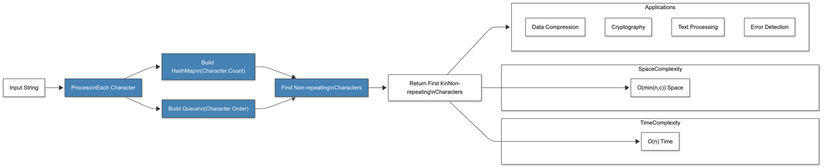
Thank you!
For tollerating me :)

Slide 21
ChatGPT
ChatGPT
ChatGPT
ChatGPT
References
If there is any queries, just create an OpenAI account and sign in to ChatGPT... You’ll get more than algorithms, iykyk...
ChatGPT
Google
Yep, that’s it

